Slide 1




NEXT GEN EMPLOYABILITY PROGRAM
Creating a future-ready workforce
Team Members
College Name
Student Name :Anubha Atshlin J R
Student ID : au960221104022
Arunachala College of Engineering
for Women

Slide 2

CAPSTONE PROJECT SHOWCASE
Project Title
Car Rentals Application with Django Framework
Abstract | Problem Statement | Project Overview | Proposed Solution | Technology Used | Modelling & Results | Conclusion

Slide 3
Abstract
This project proposes the development of a car rental web application using Django, a high-level Python web framework.
The application aims to provide users with a convenient platform to rent cars online.
Users can browse through a catalog of available cars, view details such as make, model, and rental price, and select a car for rental.
The application will also include features for user authentication, allowing users to create accounts, log in, and manage their rental bookings.
Additionally, the application will include an admin interface for managing cars, users, and bookings.
The project will leverage Django's built-in features such as authentication, ORM, and templating to efficiently develop a robust and user-friendly car rental platform.
Source :

Slide 4
Problem Statement
There is a need for a user-friendly and efficient car rental web application built
using Django.
This project aims to develop a web application that addresses these issues by
providing a streamlined online platform for car rentals.
User accounts for customers to register, manage files, and review rental history.
Search functionalities
Online booking system for users to reserve cars and manage bookings.
Secure payment processing for rental fees and potential add-ons like insurance ,
GPS etc.
Source :

Slide 5
Project Overview
The project involves the development of a comprehensive car rental application utilizing the Django,
HTML, CSS, Python, Bootstrap and JavaScript.
The application will provide an easy-to-use interface for both customers and administrators, ensuring a
seamless rental experience.
For customers, the application will provide features such as:
User Registration and Authentication
Account Management
Responsive Design
Secure Authentication
For administrators, the application will provide features such as:
Dashboard
Car Listing Management
User Account Management
Booking Management
Source :

Slide 6
Proposed Solution
.
The Proposed Solution involves in the development of car rental web application
using Django ,html, css,javascript and bootstrap.
The user account functionality allow them to create accounts, manage profiles,
and view rental history.
The car listings includes details such as car models, features , images , and
availability.
The online booking system allow users to manage their bookings , including
modifications and cancellations.
The secure payment processing allow users to pay for their rental fees and any
additional services like Insurance or GPS.
User reviews and ratings helps the customers to make informed decisions.
Source :

Slide 7


Technology Used
Front-end
Back-end
Source :

Slide 8
Modelling & Results
MODELLING:
User Model: Stores user information for registration and authentication.
Car Model: Contains details of each car such as make, model, year, price, and availability.
Booking Model: Links users with their booked cars and includes rental dates.
RESULTS:
Developed a fully functional car rental web application using Django.
Implemented user authentication, allowing users to register, log in, and manage their bookings.
Created a catalog of available cars with detailed information for users to browse and select.
Implemented a booking system for users to reserve cars for specific rental dates.
Source :

Slide 9
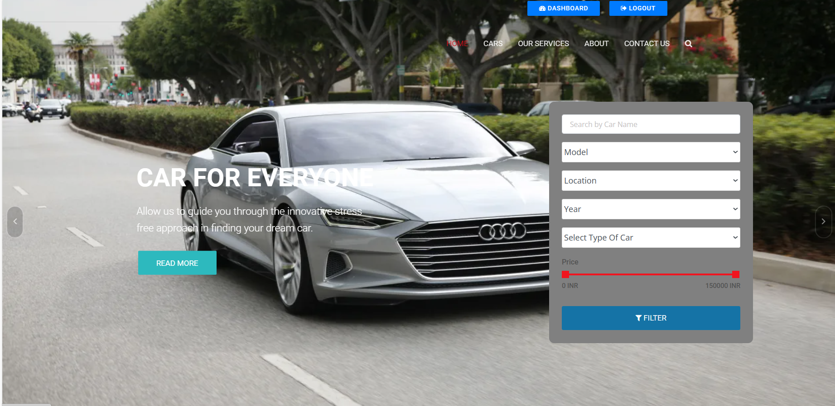
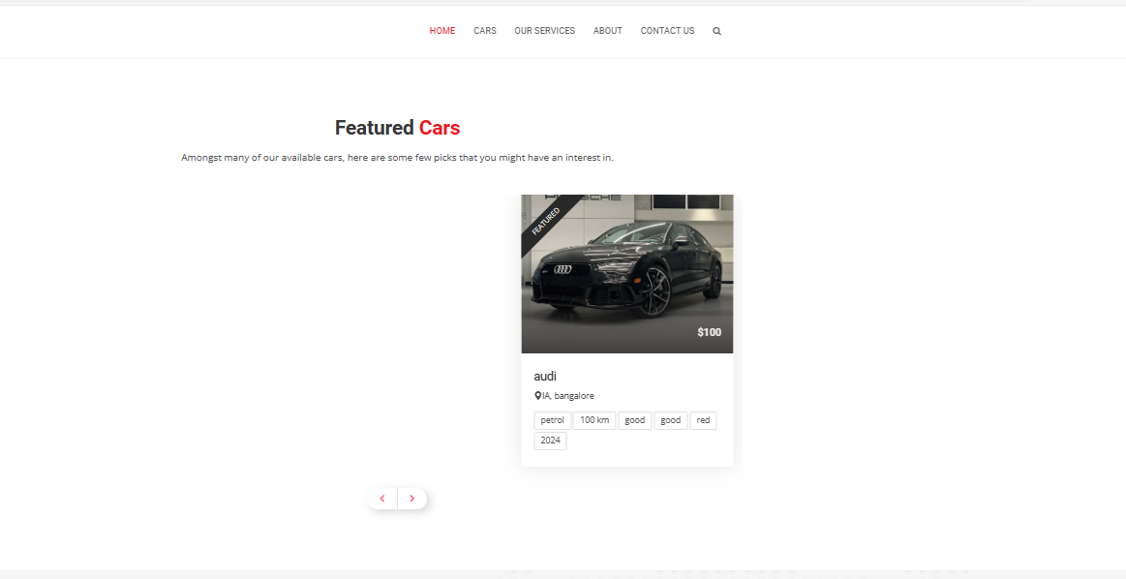
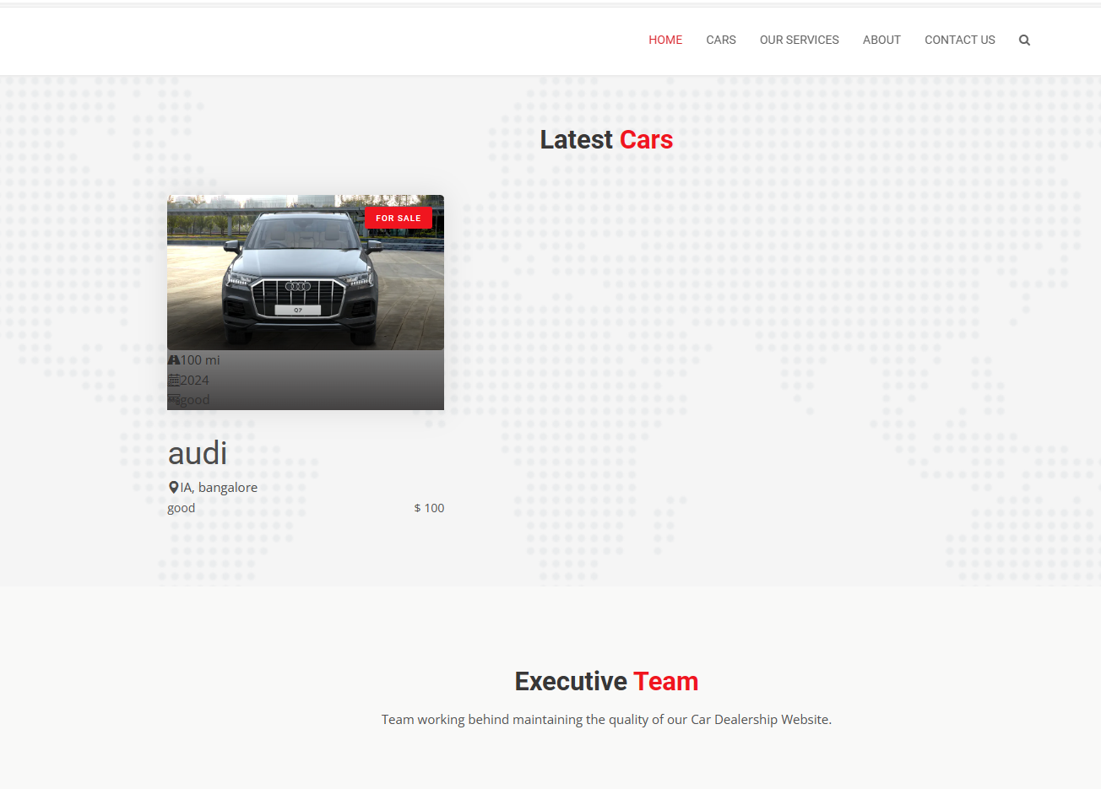
Homepage

Slide 10
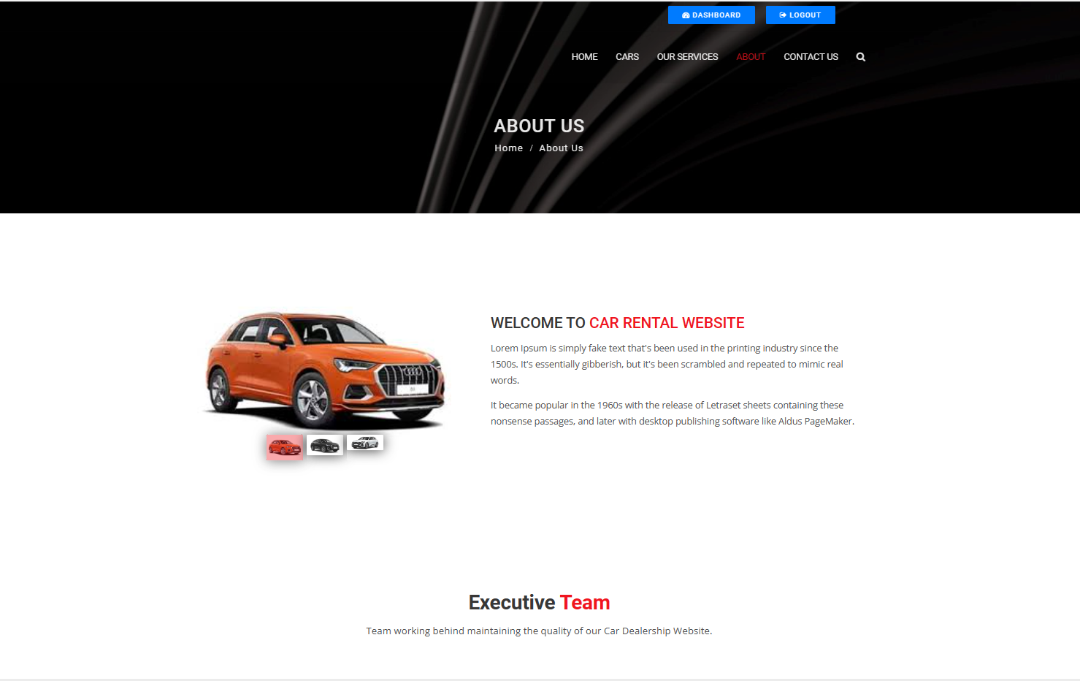
About-Us-Page

Slide 11
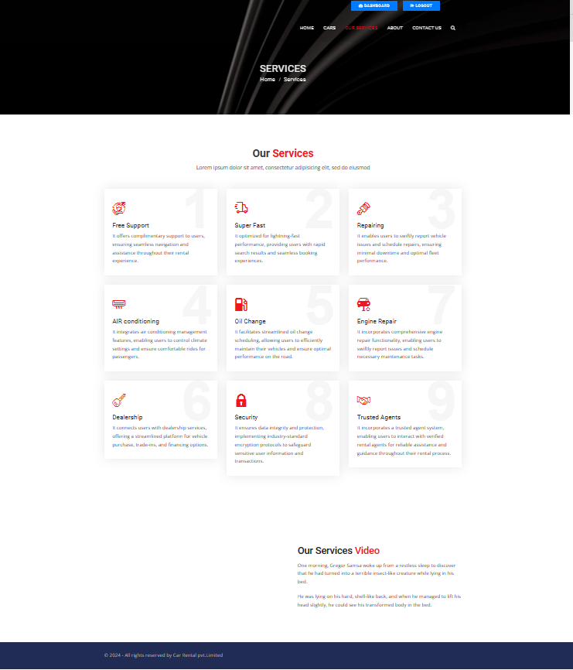
Service-Page

Slide 12
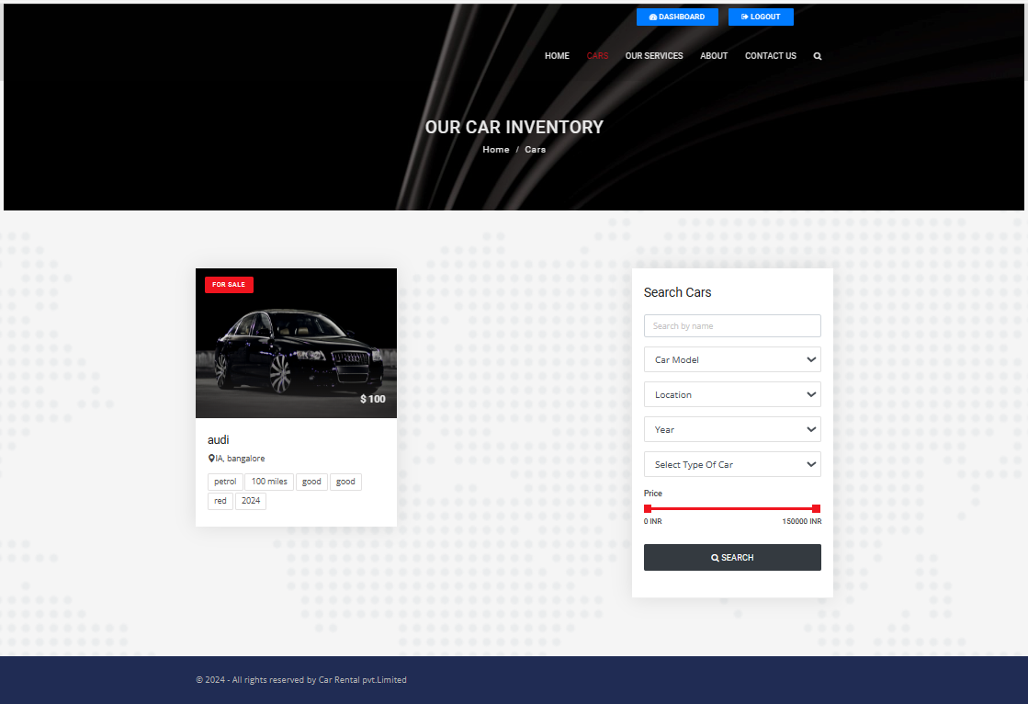
Cars-Page

Slide 13
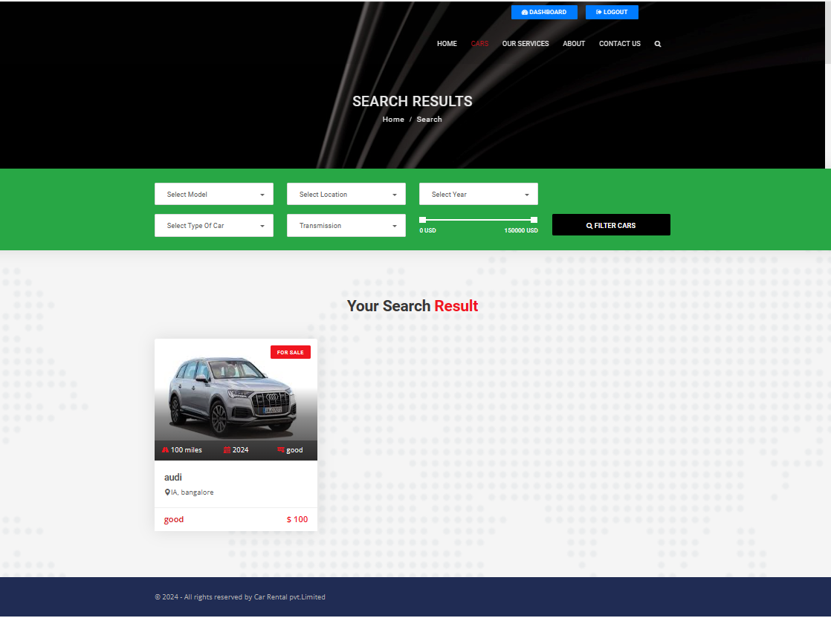
Search-Page

Slide 14
Future Enhancements:
Implement dynamic pricing based on demand, seasonality, and availability, enhancing
competitiveness.
Allow users to schedule maintenance services directly through the platform, ensuring
vehicle reliability.
Provide users with real-time navigation and traffic information for seamless travel planning.
Enable users to rent their vehicles to others, expanding the rental pool and revenue
opportunities.
Include a filter for electric or hybrid vehicles, promoting sustainable transportation choices.
Provide information on public transport options to complement car rental services, offering
comprehensive travel solutions.

Slide 15
Conclusion
Developing a car rental web application using Django offers a benefits for both customers
and rental service providers.
Django's robust framework allows for the creation of a secure, efficient, and user-friendly
platform that can streamline the rental process and enhance the overall user experience.
By implementing features such as user authentication, car listings, booking systems, and
admin dashboards, the application can cater to the needs of a wide range of users.
future enhancements such as vehicle tracking, dynamic pricing, and maintenance
scheduling can further enhance the application's functionality and competitiveness in the
market.
By continuously improving and updating the application, rental service providers can stay
ahead of the curve and meet the evolving needs of their customers.
Source :

Slide 16
Thank You!
Notes:
Thank You !!

